Slide 1
How to build a resume

Slide 2
Different Types of Resumes
Common Types of Resumes
Chronological
Functional
Combination
Chronological Resume
This is the type of resume that focuses on your recent work history
List your positions in reverse chronological order, with the most recent positions at the top and the oldest ones at the bottom.
Ultimately, the goal is to show how your positions leading up to this point have perfectly prepared you for the role you’re applying to.
Functional Resume
A functional resume, on the other hand, emphasizes the relevance of your experience.
To create a functional resume, you’ll prominently feature your professional summary, your skills and a work experience section organized by how closely the positions relate to the one you’re applying for.
A professional summary consists of a few prominent sentences that show what kind of person you are in the workplace.
This format is best for those who want to minimize resume gaps, or are transitioning into a new industry.
Combination Resume
A combination resume borrows from both of the aforementioned formats.
You’ll combine the professional summary and skills section of a functional resume with the work experience section of a chronological resume.
This format is a powerful way to stand out to recruiters by emphasizing both your experience and skills, and is useful for many different types of job seekers.

Slide 3
How to Structure a Resume
Header & Contact Info:
At the top of your resume, always include a header containing your name.
Your contact info (typically your phone number, personal email address and sometimes links to social profiles or personal websites) should be close by as well.
There should be no confusion over who the resume belongs to, or make it difficult for recruiters or hiring managers to reach out to you.
However, you may want to avoid putting your contact info in the header or footer of the document itself — the headers and footers can sometimes be overlooked by the software that scans your resume.
Professional Summary:
The professional summary is a brief, one- to three-sentence section featured prominently on your resume that succinctly describes who you are, what you do and why you’re perfect for the job.
In contrast with the largely out-of-date objective statement — a line that describes the type of career opportunity you’re looking for — professional summaries aren’t about what you want.
Instead, they’re focused on the value you could bring to a potential employer.
It’s worth noting that a professional summary isn’t an absolute must-have — if your resume is missing one, it probably won’t be a dealbreaker — but it can be a nice way to give time-pressed recruiters and hiring managers a quick, high-level overview of why you’re the right person for the job.
Skills:
Once relegated to the bottom of resumes as an afterthought, the skills section has become more and more important as recruiters and hiring managers increasingly look for candidates with specialized backgrounds.
Rather than making the folks reading your resume hunt through your bullet points to find your skills, it’s best to clearly list them.
If they see right away that you have the ability to get the job done, they’re much more likely to take your resume seriously.
Work Experience:
This critical section of a resume is where you detail your work history in a consistent and compelling format.
The Work Experience section should include company names, locations, employment dates, roles and titles you held and most importantly, bullet points containing action verbs and data points that detail the relevant accomplishments of each position.
This portion is essential for recruiters and hiring managers, who look to absorb information about your career experiences and connect your skills to what they’re looking for in a potential hire.
Recruiters are often flooded with resume submissions and have to carefully source and identify quality candidates in a crowded pack — so make sure your work experience stands out.
Education:
Since many jobs require a certain level of education, it’s important to mention your academic credentials on your resume.
However, this section shouldn’t take up too much space.
In most cases, simply listing where you went to school, when you attended and what degree you attained will be sufficient.
Additional Experience:
An optional, but potentially very valuable, addition to your resume is Additional Experience.
This is a catch-all section at the tail end of your resume that allows you to highlight volunteer experience, awards and hobbies.
Again, it shouldn’t be too long — you don’t want it to detract from your skills or work experience — but it can be a good way to provide a more well-rounded picture of who you are.

Slide 4
Design and Formatting a Resume
Design & Formatting Tips
The subject matter of your resume is ultimately what recruiters care about most.
However, that doesn’t mean you should slack off when it comes to design and formatting.
A cluttered, visually confusing resume makes it more difficult to read, and therefore more likely that recruiters and hiring managers will cast it aside. On the other hand, a sleek, polished resume will have the opposite effect.
Use these rules of thumb to ensure that your resume looks its best.
Use an easy-to-read font of no less than 11 pt.
Add margins of at least .7 inches.
Make sure there’s sufficient white space between sections.
Don’t go overboard with intricate design or decoration — touches of color are fine, but avoid any clashing or visually busy details.
If you’re going to print out copies of your resume, invest in good paper and use a high-quality printer.
Don’t save your resume as a PDF unless the application specifically says it accepts PDF files. Some applicant tracking systems scan PDFs as if they were one big image, which fails to capture your information.
Keep your resume to 1-2 pages max, unless you’re in a field like academia or medicine and must cite papers and publications.
Limit your use of colors, you’re not applying to clown college
Do not include your picture, if you get an interview they will get a look at you then

Slide 5
Edit a Resume
How to Edit Your Resume
You've written your resume, and read it twice, but that's not enough.
First, don't attempt to edit your resume until it's done.
It can be difficult to leave a glaring error while you move on to write your skills section, but force yourself to finish your resume before you edit it.
You'll save yourself time, and letting go of errors now could help you write a better first draft because you're focusing on the writing itself.
Next, never try to edit your resume right after you've written it.
Give yourself a 24-hour break before editing your resume.
With time away, you'll see your resume with fresh eyes and for what it really is—not what you meant it to be.
When you give your resume a read, try reading your resume backward. It sounds odd — and it's not always easy — but reading backward forces you to focus on each word, and helps you better catch both spelling and grammatical errors in the text.
Ask a friend or family member to read your resume, too.
They may spot errors that you missed, or have suggestions for how to show yourself in an even better light.
Then, fact-check your resume.
Check the spelling of proper nouns — think: company names, addresses, etc.
Make sure you have the current contact information for any references you've chosen to add.
These things might have changed since you last applied for a job.

Slide 6
Resume Do’s and Don’t’s
Use your full name, no nicknames
Jamal Robert McDingledorf as opposed to
Jammer Bobby MacDaddy
Professional title (if you have one)
Don’t include your latest selfie, no matter how sexy you think you look
Contact information
Your current mailing address
Your phone number
Email address
If your email is less than professional make a new one on gmail
Cute email addresses are a show stopper
Social media
There are pitfalls to this one, especially if you posted pictures of getting hammered at the local dive bar
Linkedin may be an exception
Professional Summary
Don’t talk about yourself in third person format, use I instead
Has excellent knowledge of aircraft systems
I have excellent knowledge of aircraft systems

Slide 7
Resume Do’s and Don’ts
In the experience block make good use of bullet points rather than paragraph format
Use reverse chronological order starting with your most current job
Use the same format to list your education
Don’t list irrelevant hobbies or skills, no one cares that you can strain broken glass with your teeth from a bottle of whiskey or that you can program Java script
Beware of the font nazi
Some HR people have a real hangup with this one so no cursive font or anything that’s hard to read, it will get round filed
Keep it to 1 page if you can 2 at the most
If you have more than 1 page, cover that in the interview
Use Word or PDF as a file format
Do not include religious or political statements
Make sure there are no grammatical errors
Do not exaggerate your skills

Slide 8
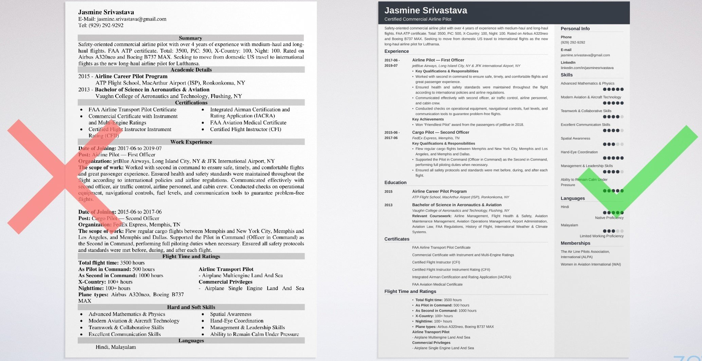
Notes:
The left is too cluttered and busy
The right make good use of a right hand margin

Slide 9
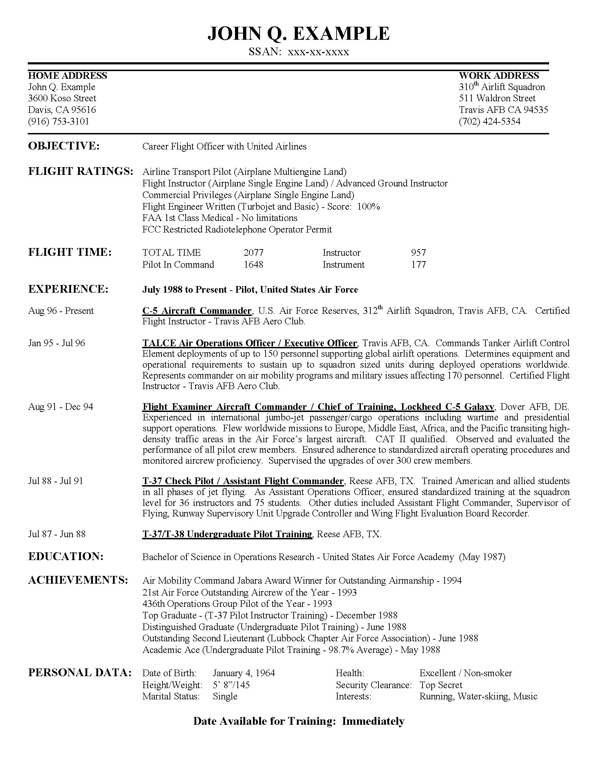
Notes:
The left the objective is not necessary delete it, otherwise layout is good
The right looks like he is applying for another airline who has those colors

Slide 10
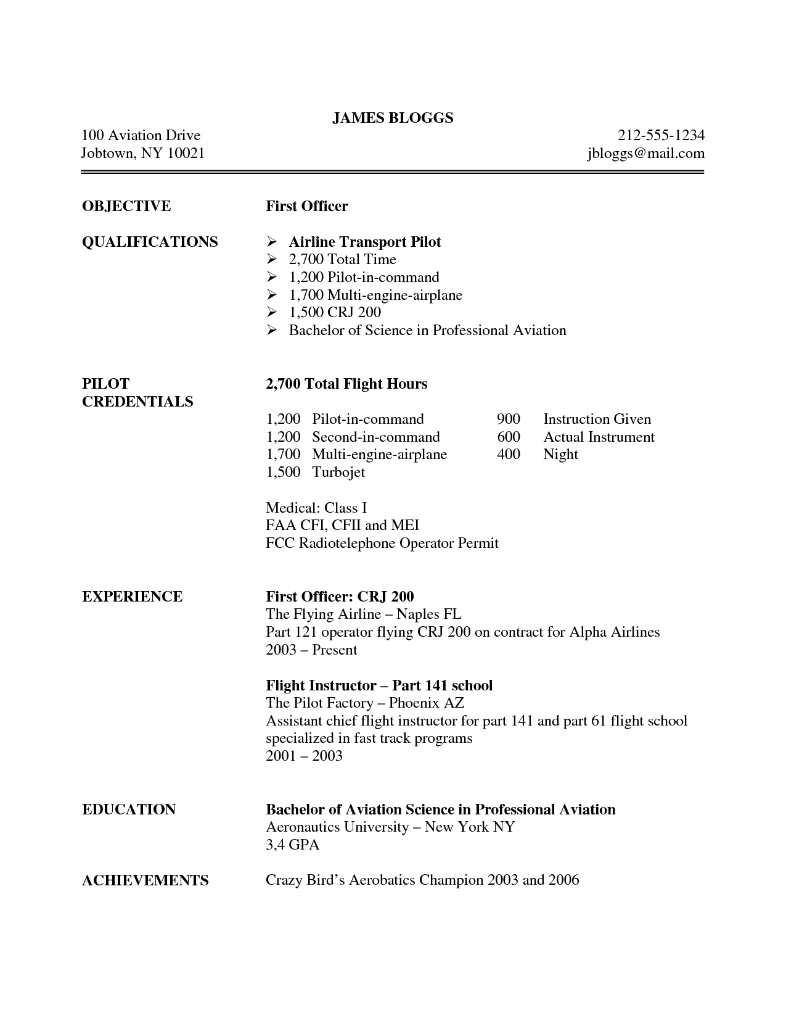
Notes:
The left do away with the objective, bullet the points in the experience section
The right somewhat confusing to read as the two columns do not line up

Slide 11
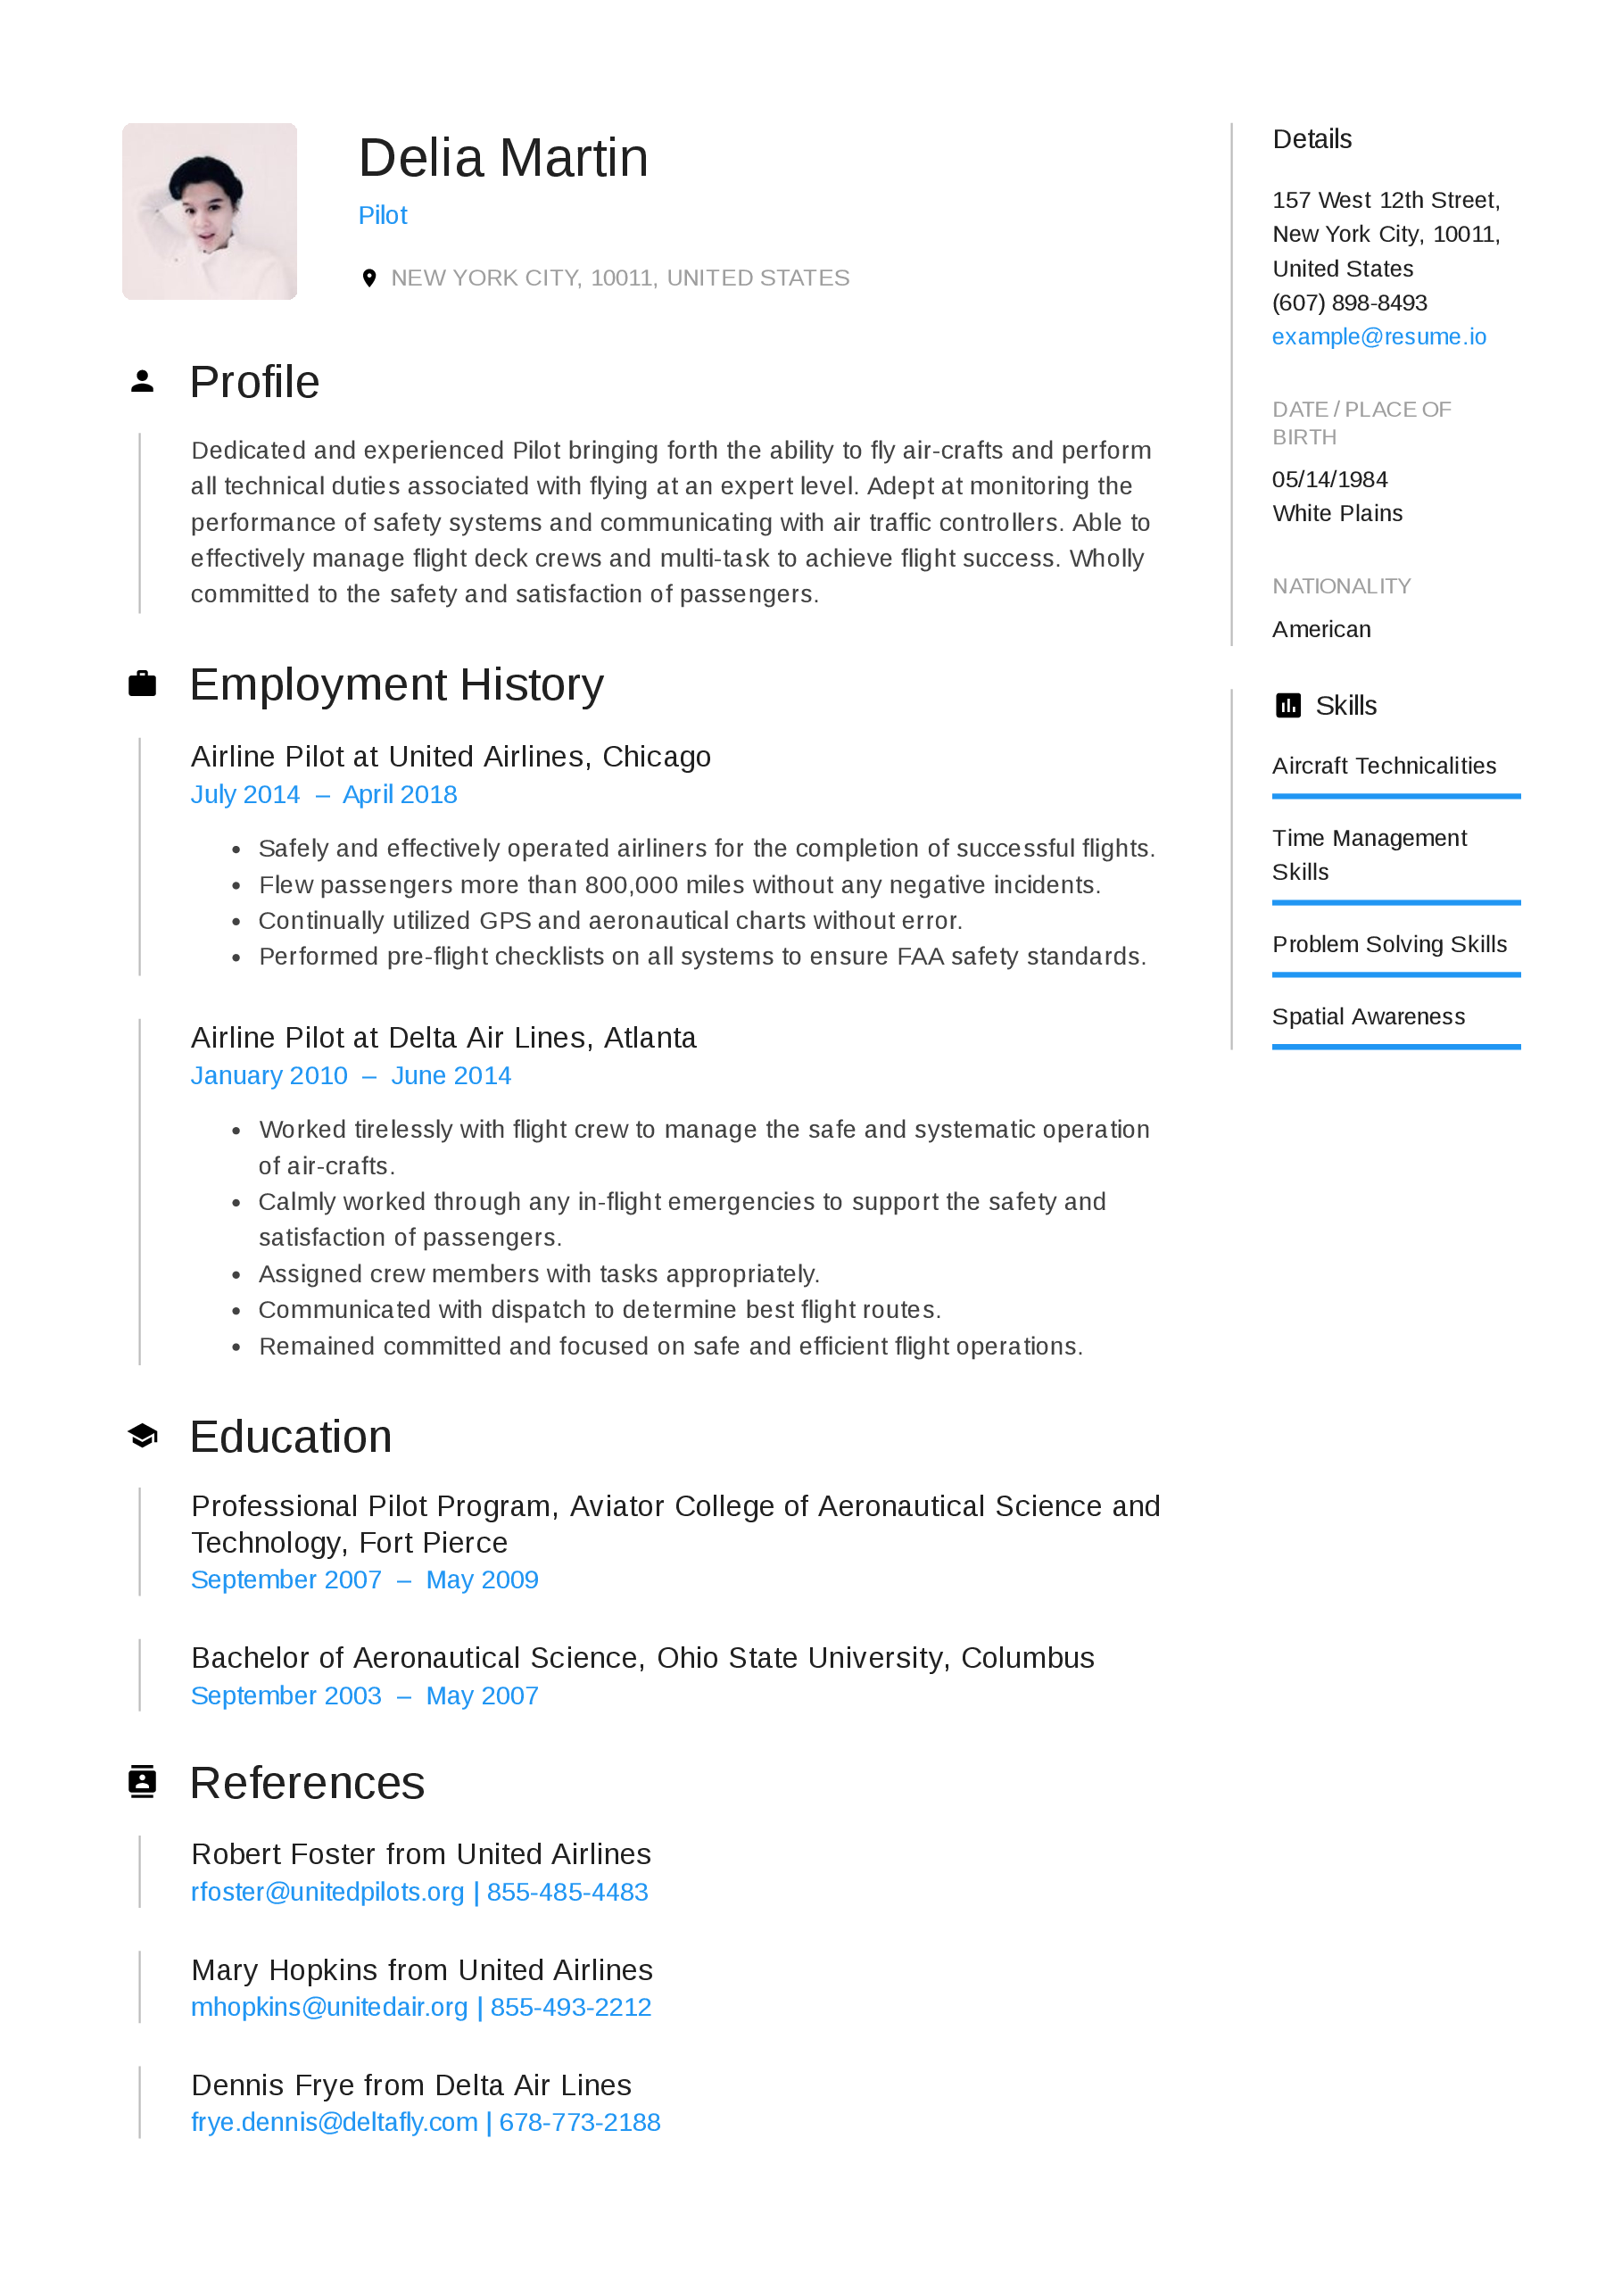
Notes:
The left do not include a photo especially one like this. Air-crafts so that’s arts and crafts on an airplane? Layout is descent “Details” should be “Contact Information”
The right they already know what your seeking. Profile is very well written would relabel it Professional Statement, rest is very good

Slide 12
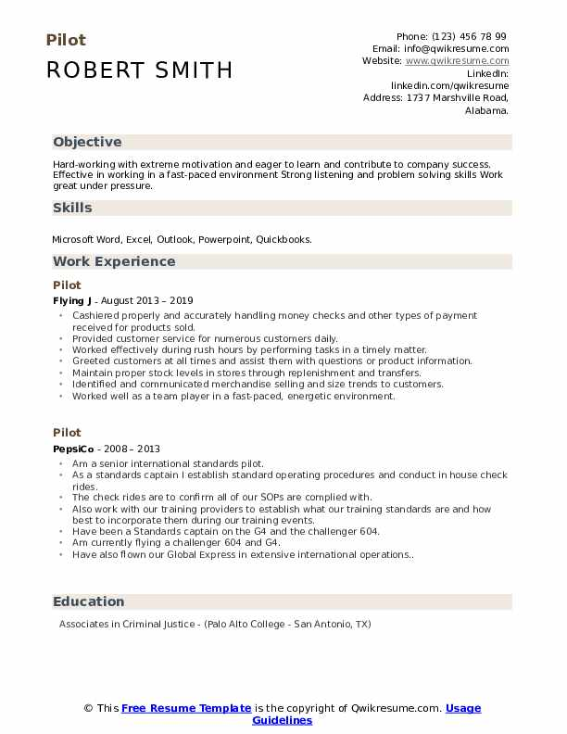
Notes:
The left Objective is mindless crap, skills are not relevant, replace Am a senior international standards pilot with Currently a senior international standards pilot, missing dates on education block
The right Objective is a waste of time and space, airplane bullets are a nice touch, good use of bolding in employment history, use more bullets in the education and military block

